Slide 1
Discrete
event
Process
Modelling Notation:
an analysis
Presented by: Cristaudo Giuseppe

Slide 2
Business Process Management
Business Process Modeling Notation
employs methods to discover, model, analyze, measure, improve and optimize business strategy and processes.
open standard to diagram a business process
It uses standardized visuals to illustrate the participants, alternatives, and process flow.
Although the diagrams are complex, readers without a background in technology will find them easy to understand.
Can be used for making:
structured
with the intention of apply business process management in real cases
cross
functional
analytical
1. Conceptual process model.
2. Process automation models for certain process automation systems by including platform- specific technical information in the form of model annotation.

Slide 3
BPMN ISSUES & LIMITATION
01
A limited concept of "business processes" as isolated "cases", which does not allow to account for any dependency between business processes (e.g., competing for resources).
02
Overloading/ambiguity of sequence flow arrows, which represent various kinds of connections, including resource-independent event flows and resource-dependent activity scheduling.
03
Insufficient integration of the objects that participate in a process.
04
Insufficient support of resource management.

Slide 4
DISCRETE EVENT PROCESS MODELLING NOTATION
BPMN-based diagram language for making (computational) process design models for discrete event simulation
01
Diagrams in the flowchart style offer a simple visual syntax for process modeling.
02
Events, actions, and (conditional and parallel) branching must all be included in a flowchart language to be considered adequately expressive.
03
Process design models must accurately and completely express the process specifications in terms of computation.
04
There is no explicit computational (control flow) semantics for BPMN’s sequence flows.

Slide 5
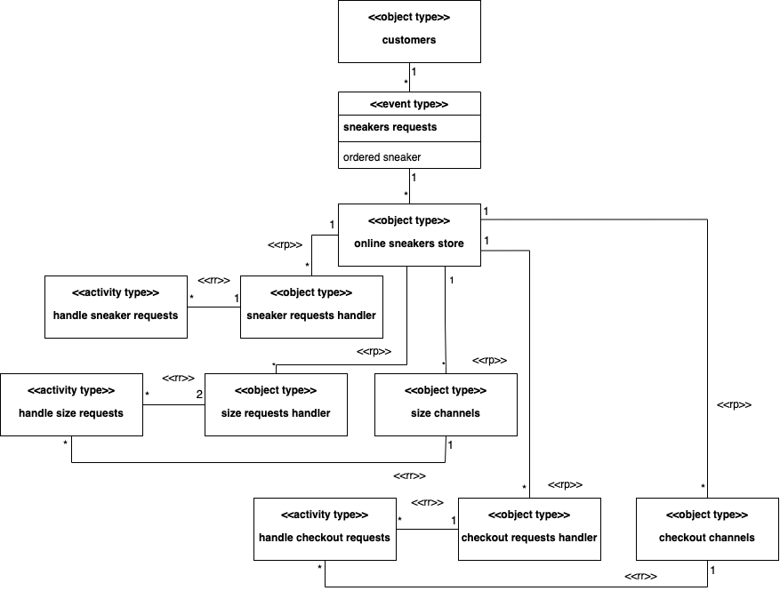
Case Study: Online Sneaker Shop
Key parameter indicator:
• Number of lost orders, • Number of total checkouts, • AVG. queue length, • Number of lost orders for size unavailable.
Object Event Class Diagram
The potentially relevant object types are:
1. online sneaker store, 2. customers, 3. orders,
4. sneakers, 5. requests, 6. size requests, 7. size channels, 8. checkout requests,
9. checkout channels.
Potentially relevant types of events and activities are: 1. sneakers requests coming in from customers, 2. sneaker request handling,
3. size request handling, 4. checkout request.

Slide 6
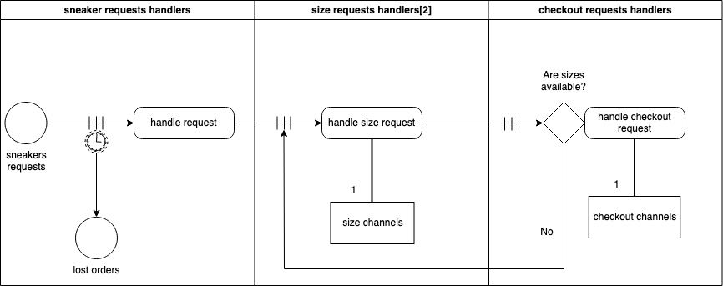
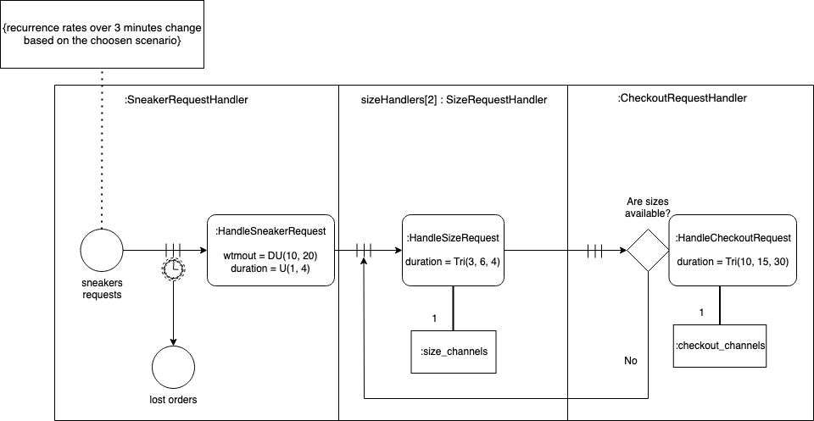
Conceptual Model
Notice how the timeout event circle (with a clock icon) is attached to the three bars of the resource- dependent activity scheduling (RDAS) arrow, representing the queue of planned taking sneakers activities waiting for the availability of a sneaker requests.
Process Design Model
The frequency of exogenous events, the duration of an activity, and the most important resource management can be displayed in a DPMN process design model to improve it.
Such an enriched DPMN process design model includes all computational details needed for an implementation without a separate explicit OE class design model.

Slide 7
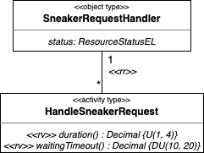
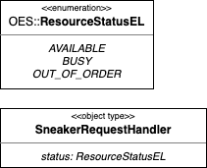
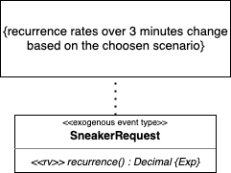

Implementation with OESjs
Objects
Events
Activity & Rules

Slide 8
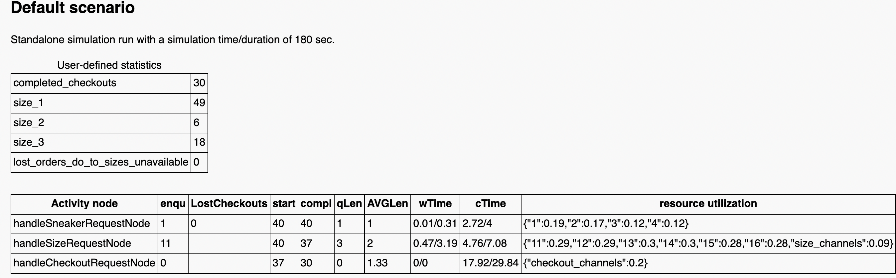
Results (1)
Simulation have been run over three different scenarios:
1. Default scenario,
2. Same architecture of the default scenario but with higher request due to a more coveted pair of sneakers,
3. High request due to a more coveted pair of sneakers, but more resources given to the online shop.
For all three scenario the number of sizes available were 60 for size 1, 20 for size 2 and 30 for size 3.
Scenario 1 results

Slide 9
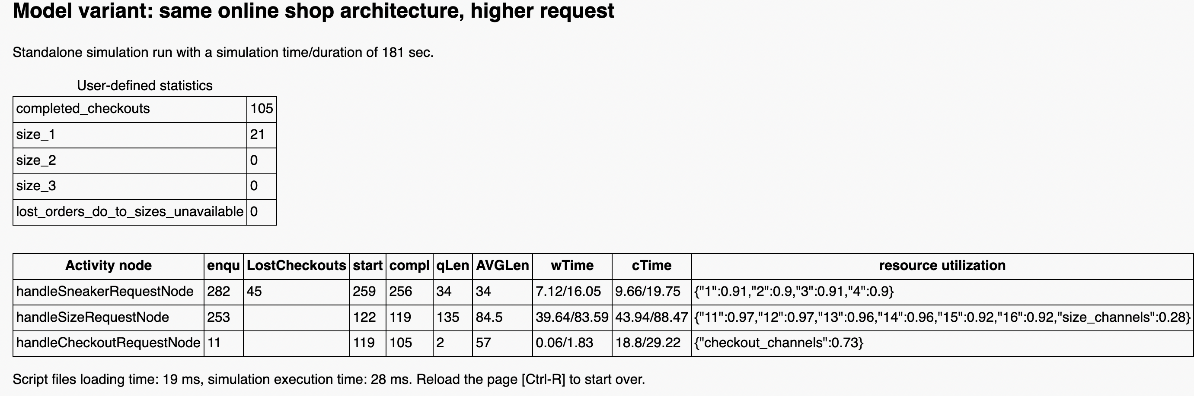
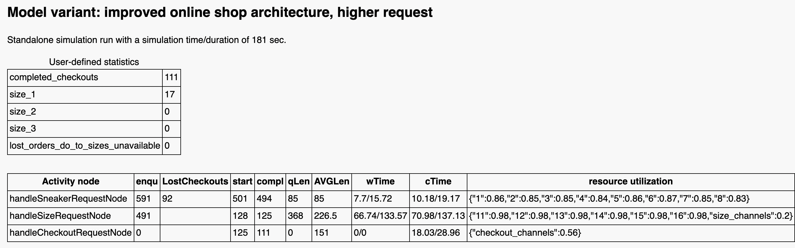
Results (2)
Scenario 2 results
Scenario 3 results

Slide 10
Conclusion & Future Work
BPMN is an effective tool for illustrating business processes bust additional standards must be used to implement it.
Even though DPMN can retain a significant portion of BPMN’s vocabulary, visual syntax, information semantics, and intuitive flowchart modeling style.
DPMN JavaScript Framework (OESjs) has also been used to demonstrate how effective it is in displaying extensive simulation results, even in simple case studies like the one proposed in this study.
DPMN is an open (non-proprietary) DES modeling language for creating platform-independent simulation design models that may be implemented with any specific DES platform, like AnyLogic, as was previously stated. As a result, as part of future development, we might want to use AnyLogic to construct the Online Sneaker Shop business process model.

